Slide 1
OTE SPEAKING PART 3: “CHOOSE TWO PICTURES AND ANSWER THE QUESTION”
One Way Idiomas. Avenida Zabalgana, Bajo 28, 01015
OXFORD TEST OF ENGLISH – Materials
COMPARE AND CONTRAST TWO PICTURES: USE LINKERS TO CREATE YOUR DISCOURSE

Slide 2
TO INTRODUCE OPINIONS
As far as I’m concerned…
As far as I know…
As far as I recognise…
To my view…
Personally,…
I think
I’m positive that…
I’m certain that…
I’m true that…

Slide 3
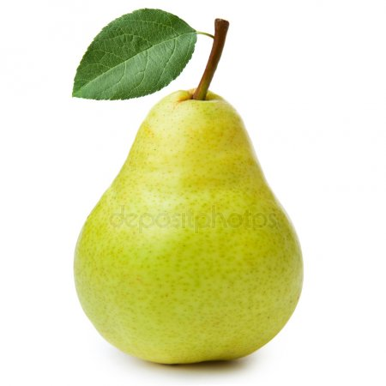
+: WHEN PICTURES LOOK SIMILAR
TO INTRODUCE AN ADDITIONAL IDEA
In addition
Furthermore
Together with that
Moreover
Besides
Also
Too
And

Slide 4
+, +: COMPARATIVE SENTENCES
TO INTRODUCE A RESTATEMENT
In fact
Indeed*
That is
Due to the fact that…

Slide 5
-: WHEN PICTURES LOOK DIFFERENT
TO INTRODUCE AN OPPOSITE IDEA
On the other hand*
In contrast
On the contrary
However
Nevertheless
Still
Nonetheless
But
Yet*
Although
Though*
Even though
In spite of + noun
Despite + noun

Slide 6
1 OR 2: CONTRASTIVE SENTENCES
TO INTRODUCE CHOICE OR ALTERNATIVE
Otherwise
Or (else)
If*
On the one hand / On the other hand
In picture A we can see… whereas in picture B there is …
…instead.
While in picture A we can see… in picture B there is…

Slide 7
1…
TO INTRODUCE AN EXAMPLE
For example
For instance
As an illustration
To make myself clearer…

Slide 8
1, 2, 3, etc.
TO LIST IN ORDER
First
Second
Next
Last
Finally
In the first/second/third/…/ place

Slide 9
.
TO INTRODUCE A CONCLUSION OR SUMMARY
Clearly
Thus,…
In brief
In conclusion
Indeed*
In short
In summary

Slide 10
THANK YOU!

